Slide 1
Dynamic Payment Orchestration Al-Powered Real-Time Rail Selection
Reducing failures, delays, and inefficiencies
in multi-rail payment execution.

Slide 2
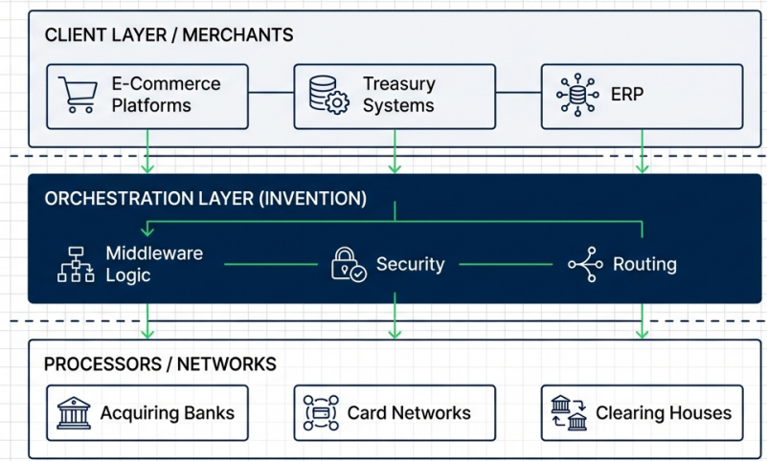
Field of the Invention & Context
DOMAIN: Electronic Fund Transfers (EFT) & Automated Routing.
SCOPE: The middleware layer bridging Merchant Core Engines and external PSPs.

Slide 3
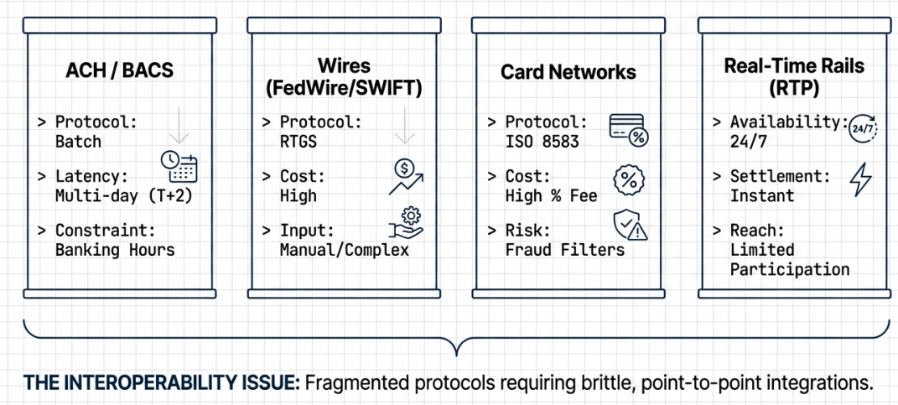
Background (Prior Art) - The Multi-RaiI Ecosystem
THE INTEROPERABILITY ISSUE: Fragmented protocols requiring brittle, point-to-point integrations.

Slide 4
Technical Limitations of Conventional Systems
Static / Rule-Based Routing
Logic limited to rigid if-then statements (e.g., "If Region=US, use Provider A"). Cannot adapt to real-time network degradation.
Temporal Constraints
Hard dependency on banking windows. Result: Significant downtime during weekends and holidays.
Generic Error Handling
Systems return binary "Success/Fail" signals without actionable granular data, forcing manual triage.
Rail Downtime
Blind submission to downed networks due to lack of real-time health monitoring.
Fragmented Ledgers
No single source of truth. Reconciliation requires aggregating discordant reports from multiple PSPs.

Slide 5
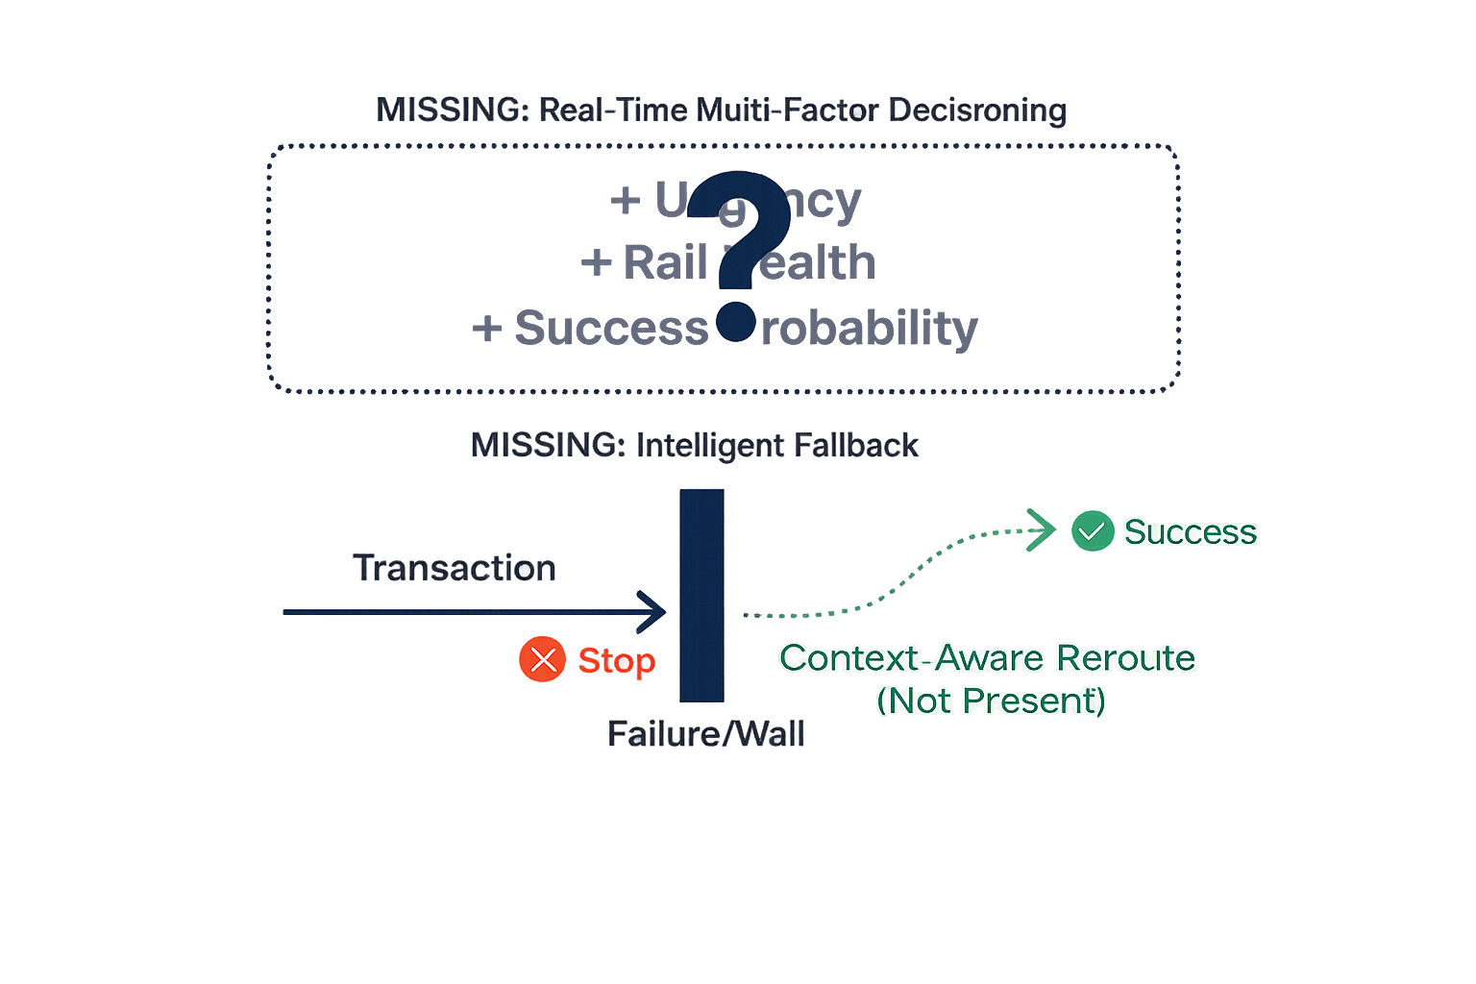
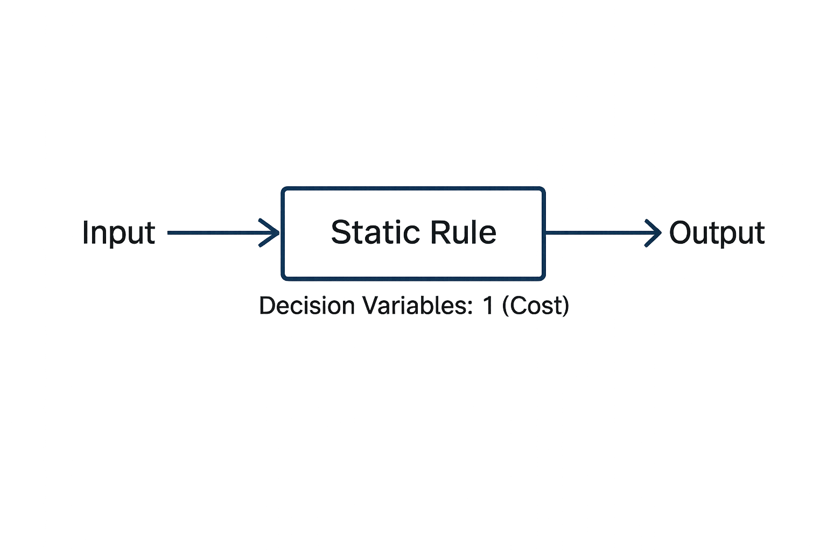
The Technical Gap
THE GAP ISSUE: Lack of real-time, intelligent decisioning and resilient fallback mechanisms creates operational friction and inefficiency.

Slide 6
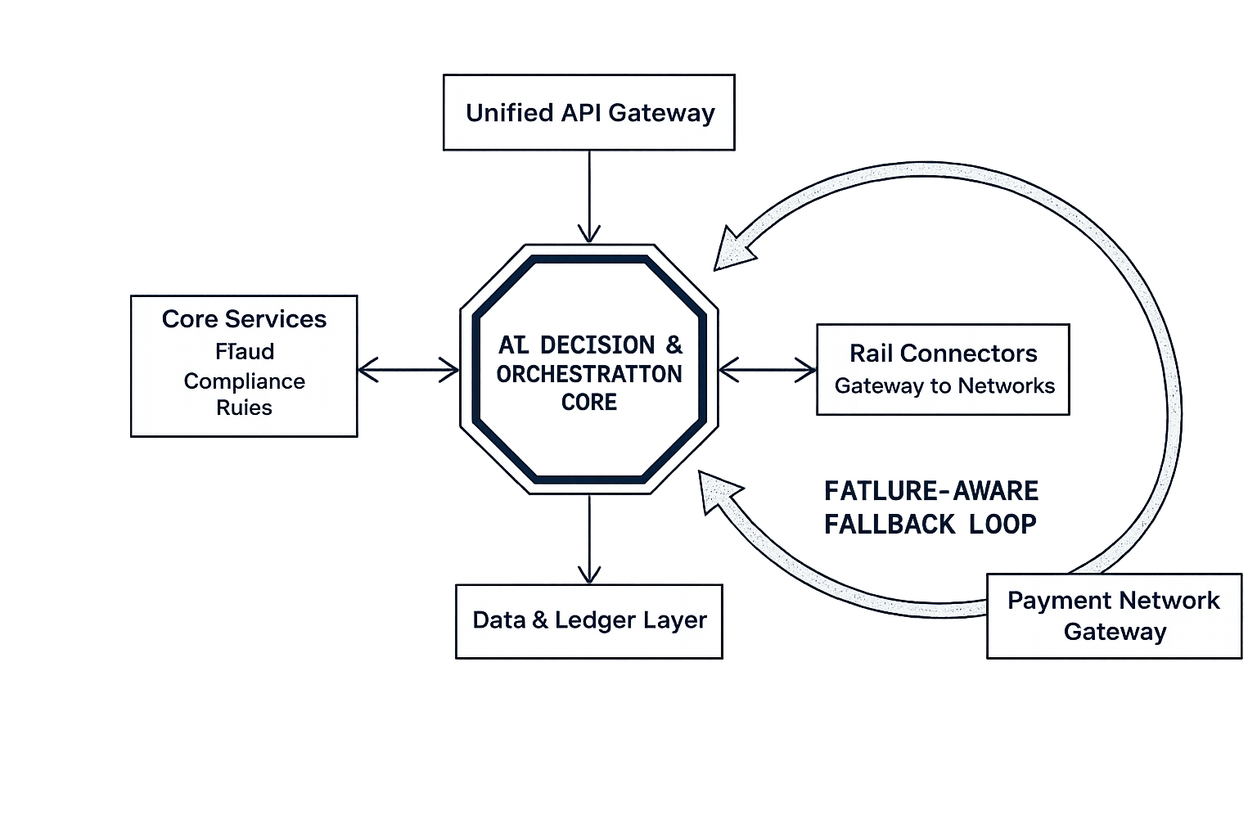
Solution Overview — Al-Powered Unified Payments Core
SYSTEM DEFINITION: A self-learning orchestration layer acting as a
central intelligence hub between business systems and payment networks.

Slide 7
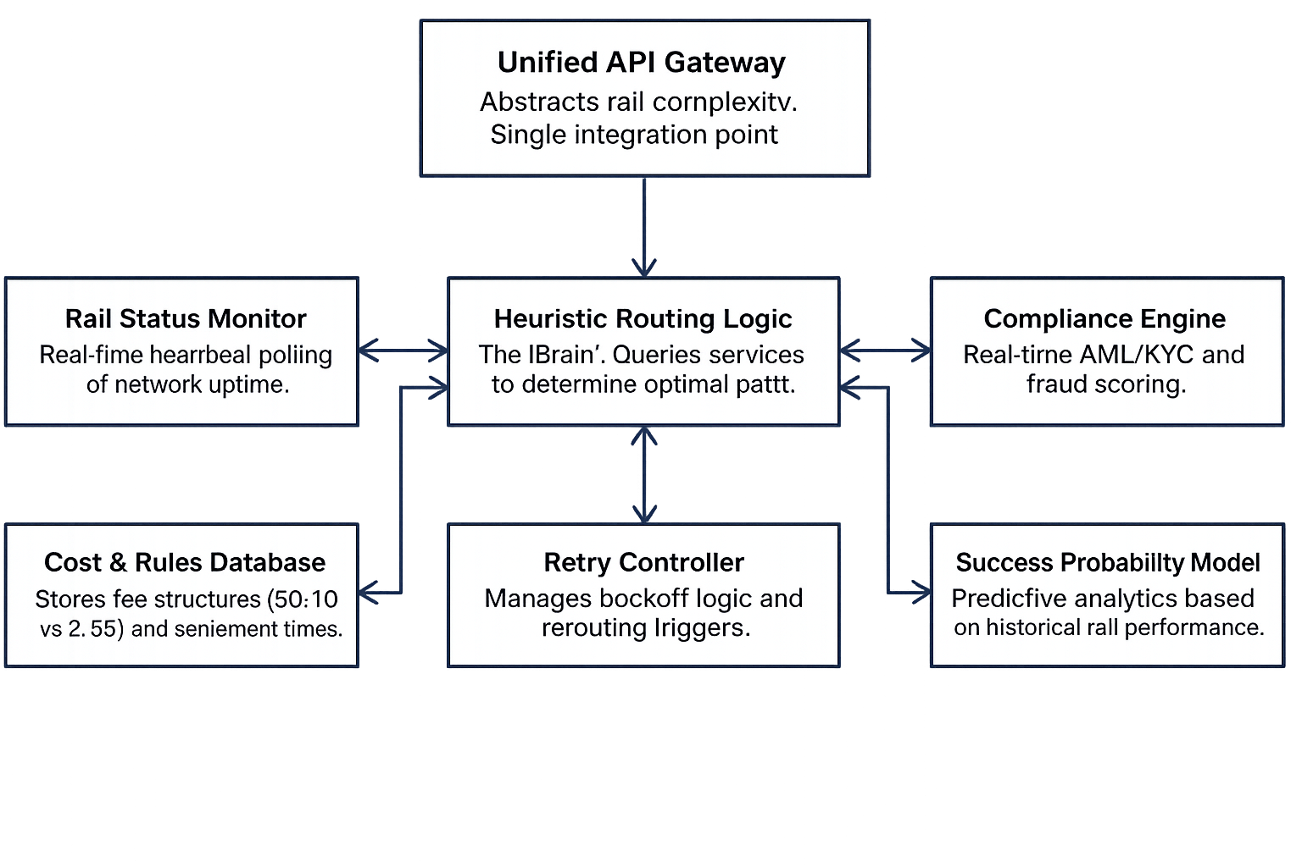
Core System Components

Slide 8
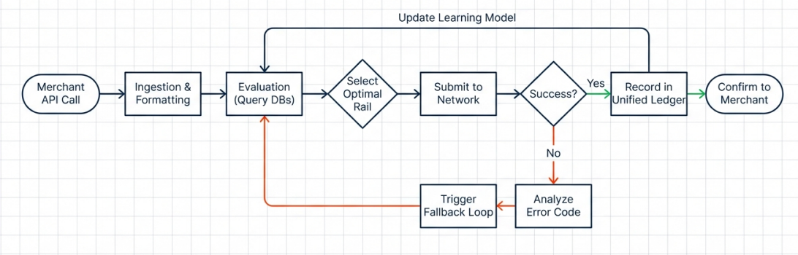
Solution Flow Diagram

Slide 9
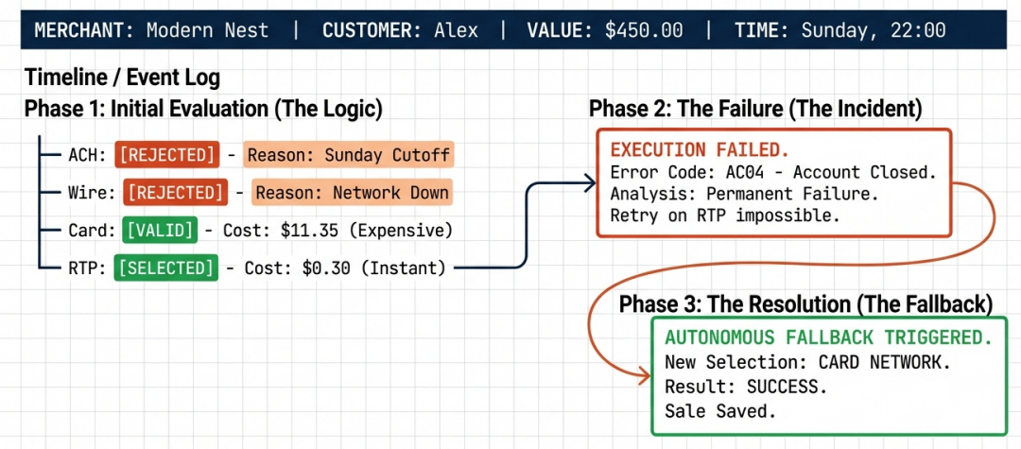
Real-Time Scenario (Preferred Embodiment)

Slide 10
Novelty & Patent Value
Autonomous Multi-Factor Decisioning
Simultaneous analysis of Cost, Speed, Risk, and Rail Health, moving beyond static rule sets.
Failure-Reason-Based Rerouting
Novel logic distinguishing between transient errors (retry) and permanent errors (AC04 -> Reroute).
Constraint-Aware Retry Policy
Automated adherence to external temporal constraints (banking hours) during the retry phase.
Self-Learning Feedback Loop
System updates predictive models based on specifc error codes (e.g., learning a specific account is not RTP-enabted) .

Slide 11
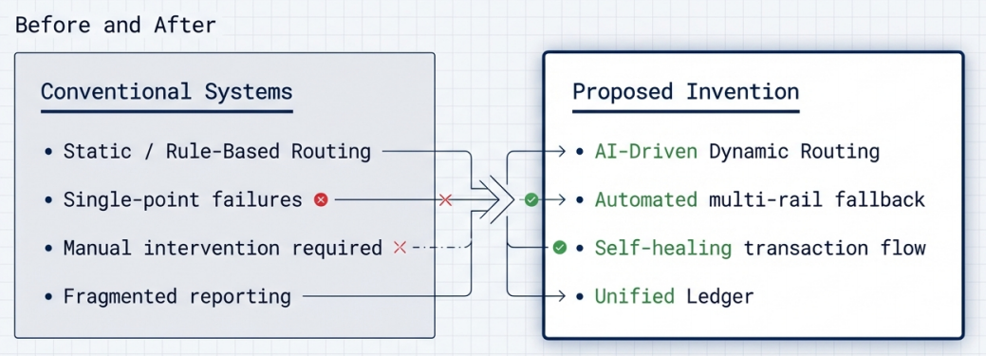
Summary of Invention Utility
TRANSFORMING PAYMENT PROCESSING FROM A MANUAL, BRITTLE COLLECTION OF POINT SOLUTIONS INTO A STRATEGIC, SOFTWARE-DEFINED, AUTONOMOUS PLATFORM.

